Slide 1




Peoples Empowerment Group
ISBM COLLEGE OF ENGINEERING, NANDE, PUNE
A
Project Presentation
On
IOT Scribe System for Visually Impaired Students
Team Members:- 1.Sanket Sherki
2.Om Rajesh Mallepelli
3.Vaishnav Waghre

Slide 2
PROBLEM STATEMENT
The Reality Today:
• Visually impaired students depend on human scribes
• Leads to bias, privacy loss & recurring cost
• Existing digital exams are visual-first
• Inclusive exam tools are missing

Slide 3
OBJECTIVES
Design an assistive examination device for visually impaired students.
Convert examination questions into audio instructions.
Allow students to select answers using dedicated buttons.
Display the selected answer for invigilator verification.
Store examination responses digitally.
Enable wireless transfer of examination data using IoT.
Develop a low-cost and user-friendly solution.

Slide 4
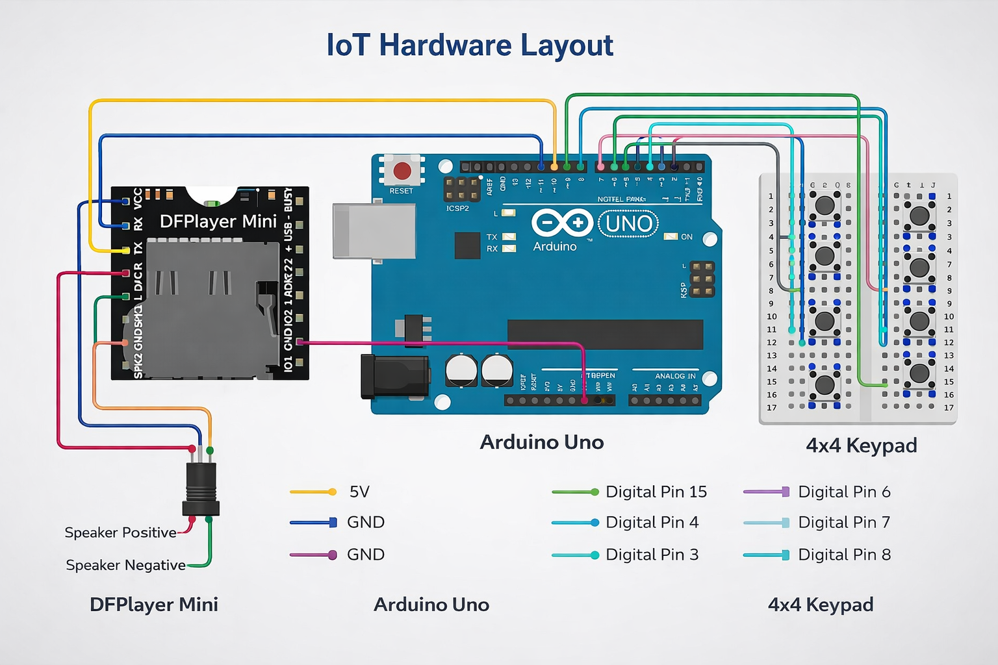
SPECIFICATIONS
🔧 Hardware:
Arduino Uno
DF Player Mini + headphone
Bluetooth HC-06
Keypad / Buttons
SD Card Module
💻 Software:
Arduino IDE (C/C++)
Python (Backend)
HTML/CSS (Interface)

Slide 5
KEY FEATURES
• Enables independent exam writing
• Eliminates recurring scribe costs
• Works offline
• Low-cost hardware solution
• Promotes inclusive education
• Scalable nationwide

Slide 6
GOALS
Primary Goal
Develop an accessible examination system that allows visually impaired students to answer MCQ examinations independently.
Secondary Goals
Reduce dependence on scribes.
Improve examination accuracy.
Enhance accessibility in education.
Support digital examination systems.
Promote inclusive education.

Slide 7
EXISTING SYSTEM
Current examination methods include:
Human Scribe
Advantages
Easy to arrange (sometimes)
No electronic device required
Disadvantages
Human errors
Privacy issues
Availability problems
Student depends on another person
Communication misunderstandings
Computer-Based Screen Reader
Advantages
Audio assistance
Faster operation
Disadvantages
Expensive
Requires computer skills
Not available in every examination center
Internet/computer dependency

Slide 8
APPLICATIONS OF PROJECT
• School & college examinations
• Competitive exams for disabled students
• Government inclusive education programs
• Rural education centers
• Special needs institutions

Slide 9
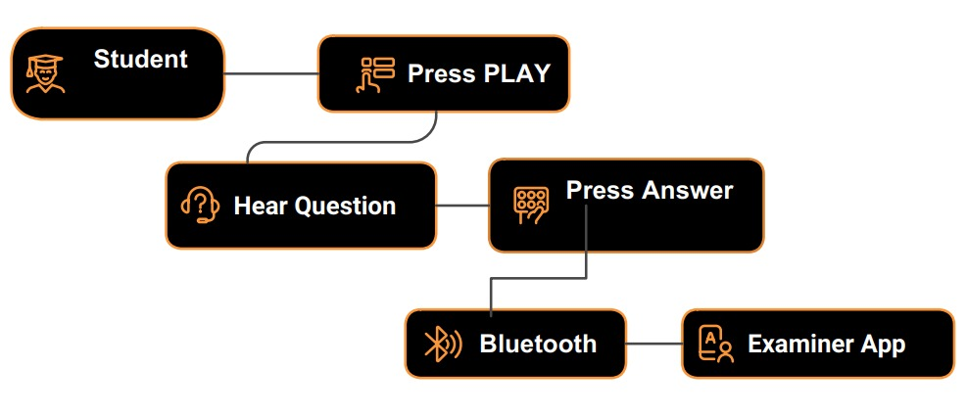
Proposed System
Workflow
Teacher uploads MCQ questions.
ESP32 controls the entire system.
DFPlayer Mini plays question audio.
Student listens to:
  Question
  Option A
  Option B
  Option C
  Option D
Student presses answer button.
OLED displays selected option.
Answer is stored.
Data is sent via Wi-Fi to teacher/server.
Final score/report is generated.

Slide 10
Research Paper Study
Paper 1 (2025)
Title: Assistive Technologies for the Visually Impaired: A Review
Authors: Farzad Cheraghpour Samavati, Ali Rahimi Ghasem Abadi
Journal: Cureus Journal of Computer Science (2025)
DOI: 10.7759/s44389-025-06891-1
Objective
Reviews AI-powered assistive technologies for visually impaired users.
Focuses on speech interfaces, multimodal interaction, wearable devices, and accessibility.
Key Findings
Audio and multimodal interfaces improve accessibility.
Low-cost, offline assistive devices are needed.
User-friendly interfaces increase technology adoption.
AI, IoT, speech processing, and multimodal feedback are emerging trends.
Relation to Our Project
Supports the IoT Scribe System for Visually Impaired Students by recommending audio guidance, affordable ESP32-based hardware, and IoT-enabled assistive technology for independent examination support.
Paper Link
🔗 https://doi.org/10.7759/s44389-025-06891-1
or
🔗 https://www.cureus.com/articles/44389-assistive-technologies-for-the-visually-impaired-a-review

Slide 11
Research Paper Study
Paper 2 (2026)
Title: IoT-powered Wearable Assist Device for Visually Impaired
Authors: Lokesh S., Sukesh P., Tejaswini S., Meera M., Udhayakumar G.
Journal: Disability and Rehabilitation: Assistive Technology (2026)
DOI: 10.1080/17483107.2025.2582033
Objective
Develops an IoT-enabled wearable assistive device for visually impaired users.
Integrates ESP32-CAM, ultrasonic sensors, object detection, and voice feedback to improve mobility and environmental awareness.
Key Findings
IoT-based wearable devices improve mobility and independence.
Real-time object detection and voice feedback enhance accessibility and safety.
ESP32-CAM with ultrasonic sensors provides a low-cost and efficient assistive solution.
Achieved over 90% recognition accuracy with low computational latency.
Relation to Our Project
Supports the proposed IoT Scribe System for Visually Impaired Students by validating the use of ESP32-based IoT hardware, audio guidance, and affordable embedded systems to improve accessibility and independence during examinations.
Paper Link
🔗 https://pubmed.ncbi.nlm.nih.gov/41182323/
or
🔗 https://doi.org/10.1080/17483107.2025.2582033

Slide 12
Thank You

